Slide 1

Mixed Reality
Where the physical and digital worlds converge to create new realities

Slide 2

PRESENTED BY : MD. Talha Zobaer ID: 21010136 Session : 2021-22 IOT and Robotics Engineering(IRE) Bangabandhu Sheikh Mujibur Rahman Digital University

Slide 3

SUPERVISED BY :
Md Masud Rana
Lecturer
Cyber Security Engineering
Bangabandhu Sheikh Mujibur Rahman Digital University

Slide 4
Contents of this template
Number | Title | Key Points
1 | Introduction to Mixed Reality | Definition, Overview of Mixed Reality
2 | The Evolution of Mixed Reality | Timeline of key developments, Important milestones
3 | How Mixed Reality Works | Technology behind MR, Diagram of real and virtual interaction
4 | Applications of Mixed Reality | Education, Healthcare, Entertainment, Industry
5 | Benefits of Mixed Reality | Enhances learning and training, Improves efficiency, Immersive
6 | Challenges and Limitations | Technical challenges, High costs, Privacy and security concerns
7 | Future of Mixed Reality | Emerging trends, Impact on industries, Vision for the future
8 | Conclusion | Recap of key points, Final thoughts

Slide 5

MR
What is MR?
Lets go to learn about it----

Slide 6
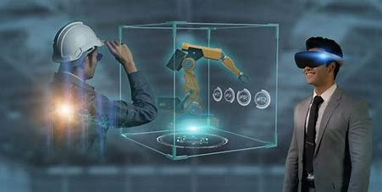

Introduction
Introduction
Mixed reality (MR) merges the real and virtual worlds to produce new environments where physical and digital objects co-exist and interact in real-time.

Slide 7

Table of Contents
01
02
Real-time interaction
Context awareness:
03
04
Immersive experiences:
Real Life Exprence
Key Component :
Users interact with both physical and digital elements simultaneously.
MR adapts to and understands the user's environment.
Merges the best of VR and AR for engaging, interactive experiences.
Elabrate real life expence

Slide 8

Literature Review
overview
Application
MR bridges the gap between virtual reality (VR) and augmented reality (AR), allowing users to interact with both physical and digital objects seamlessly.
MR is used in gaming, education, healthcare, design, training, and remote collaboration, offering new possibilities for work and entertainment by bridging the physical and digital worlds.

Slide 9

The Evolution of Mixed Reality
.
.

Slide 10

Two Theories
1
2
1968: Ivan Sutherland creates the first head-mounted display system.
1994: Paul Milgram introduces the Reality-Virtuality Continuum.
2007: The term "Mixed Reality" gains traction with the development of advanced MR devices.

Slide 11
Two Columns
Milestone
Future
Introduction of Microsoft's HoloLens in 2016 and 2020’s industrialization.
MR is set to become a mainstream technology, transforming industries and daily life.

Slide 12

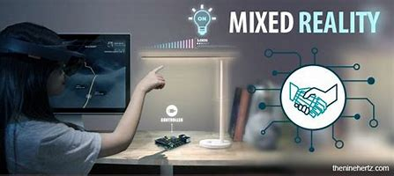

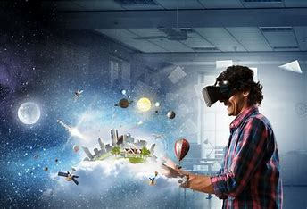
Technology Of MR
Two Points of View
.
Utilizes advanced sensors, cameras, and software to map the real world and overlay digital content.
Combines input from various devices, such as VR headsets, AR glasses, and motion sensors.

Slide 13
Feedback
Process
USES
Learning
Production
.
Entertainment
Advanced Work

Slide 14

Study Objectives
Education
Industry
Entertenment
Virtual classrooms and interactive learning modules enhance student engagement and understanding.
Virtual prototypes allow for faster product development and remote assistance improves field service efficiency
Immersive gaming experiences and virtual concerts provide new forms of entertainment

Slide 15
Three
Columns
Education
Industry
Global villege
Benefits :
Enhances Learning and Training
Improves Efficiency and Productivity
Facilitates Remote Collaboration

Slide 16
Points of Discussion
Challenges and Limitations
Technical Challenges
High Costs
Privacy and Security Concerns
Issues like latency, accuracy, and real-time processing must be addressed for seamless MR experiences
Development and deployment of MR solutions can be expensive, limiting accessibility
MR devices collect vast amounts of data, raising concerns about privacy and data security.

Slide 17
Event
Timeline
Trends
Impact on Industries
Advances in 5G, AI, and edge computing
Providing immersive and interactive experiences.
More affordable and user-friendly MR devices
Part of daily life, transforming how we work, learn, and play.
Affordable
Vision for the Future

Slide 18
Dissertation Review
Negative
Positive
Technical Challenges
High Costs
Privacy and Security
Accessibility Issues
Health and Safety
Enhanced Learning and Training
Increased Productivity and Efficiency
Innovative Entertainment
Advanced Healthcare
Design and Prototyping

Slide 19

Thanks

